Slide 1
HOTEL BOOKING ANALYSIS
CAPSTONE PROJECT
Presented By
S Mohamed Ameen- 2021306030 - Departement of leather technology- Alagappa college of technology, Anna University

Slide 2
OUTLINE
Problem Statement
Proposed System/Solution
System Development Approach
Algorithm & Deployment
Result
Conclusion
Future Scope
References

Slide 3
Problem Statement
Develop a comprehensive predictive model to determine the optimal timing for hotel room bookings, identify the ideal length of stay for obtaining the best daily rates, and predict the likelihood of hotels receiving an elevated number of special requests based on historical data.

Slide 4
Proposed Solution
Utilizing advanced machine learning algorithms, our solution will analyze extensive historical hotel booking data to establish patterns and correlations.
• For optimal timing, a predictive model will consider factors such as seasonality, demand fluctuations, and promotional periods, providing users with insights on when to secure the most cost-effective room rates.
• The ideal length of stay will be determined through data-driven analysis, considering variables like day-of-week trends and duration-specific pricing strategies.
• Additionally, a specialized model will predict the likelihood of hotels receiving elevated special requests by examining guest profiles, reservation details, and hotel amenities, enabling proactive management strategies for enhanced customer satisfaction.
This holistic approach aims to empower travelers and hoteliers alike with actionable intelligence for strategic decision-making in the dynamic hospitality landscape.

Slide 5
System Approach
Building the proposed solution would involve a combination of data processing, feature engineering, and machine learning. Here are the key system and library requirements:
System Requirements:
Hardware:- A computer with sufficient processing power, preferably with multiple cores or a GPU for faster training of machine learning models.- Adequate RAM to handle the size of the dataset and computational requirements.
Software: An operating system compatible with the required machine learning libraries (e.g., Windows, Linux, macOS).

Slide 6
System Approach
Library Requirements:
Data Processing and Analysis:-
Pandas: For data manipulation and analysis.-
NumPy: For numerical operations on data.
Data Visualization:-
Matplotlib and Seaborn: For creating visualizations to understand data patterns.
Plotly or Bokeh: Interactive visualization libraries for more complex visualizations.edunet

Slide 7
Algorithm & Deployment
Algorithm Selection
Data Exploration:
• Explore the hotel_booking dataset's structure, features, and target variable(s).
• Identify potential patterns, correlations, and outliers.
Problem Formulation:
• Define the problem: Predict optimal booking times, ideal length of stay, and likelihood of special requests based on historical data
.Algorithm Selection:
Regression tasks (e.g, predicting daily rates):• Consider linear regression, decision trees, or ensemble methods (XGBoost, LightGBM).• Classification tasks (e.g, predicting special requesth):• Consider logistic regression, decision trees, or random forests.

Slide 8
Algorithm & Deployment
Data Input:
Data Collection:
• Gather historical hotel booking data, including information on booking dates, length of stay, special requests, guest profiles, and relevant hotel details.
Data Cleaning:
• Handle missing values, outliers, and any inconsistencies in the dataset.
• Convert categorical variables into numerical representations through encoding techniques.
Feature Engineering:
• Create new features or modify existing ones based on domain knowledge.
• Extract meaningful information from date gariables, such as day-of-week or month.

Slide 9
Algorithm & Deployment
Training Process:
Data Splitting:
• Divide the dataset into training and testing sets to evaluate the model's performance.
Feature Sealing:
• Standardize or normalize numerical features to ensure they have a consistent scale.
Model Training:
• Use the selected algorithm to train the model on the training dataset.
• Adjust hyperparameters to optimize model performance.
Model Evaluation:
• Evaluate the model on the testing dataset using appropriate metrics (e.g., Mean Squared Error for regression, accuracy, precision, recall for classification).
• Fine-tune the model if necessary..

Slide 10
Algorithm & Deployment
Prediction Process
New Data Input:
• Collect new data or use existing data to make predictions.
Preprocessing:
• Apply the same data preprocessing steps (cleaning, feature engineering, scaling) to the new data.
Model Inference:
• Use the trained model to make predictions on the new data.
Results Interpretation:
• Interpret the model's predictions in the context of the problem at hand.
• For regression, interpret the predicted valubs as optimal rates or lengths of stay. For classification, interpret predictions as the likelihood of special requests.

Slide 11
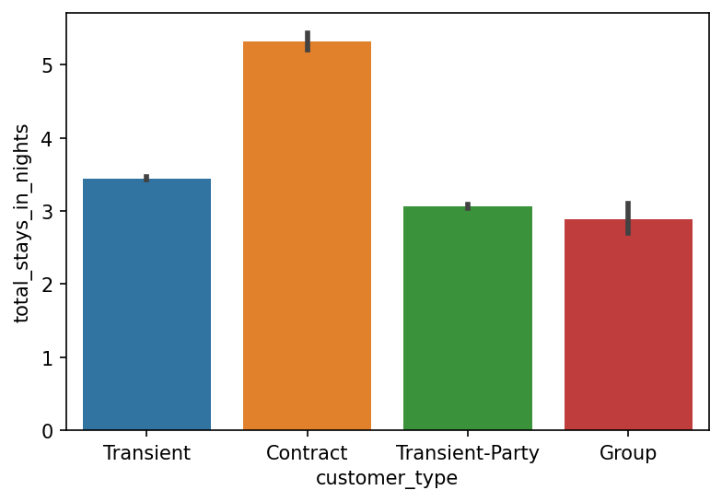
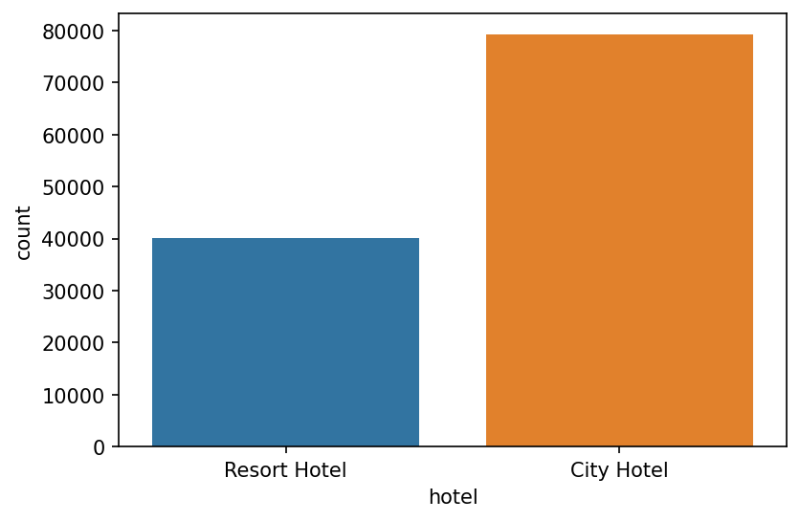
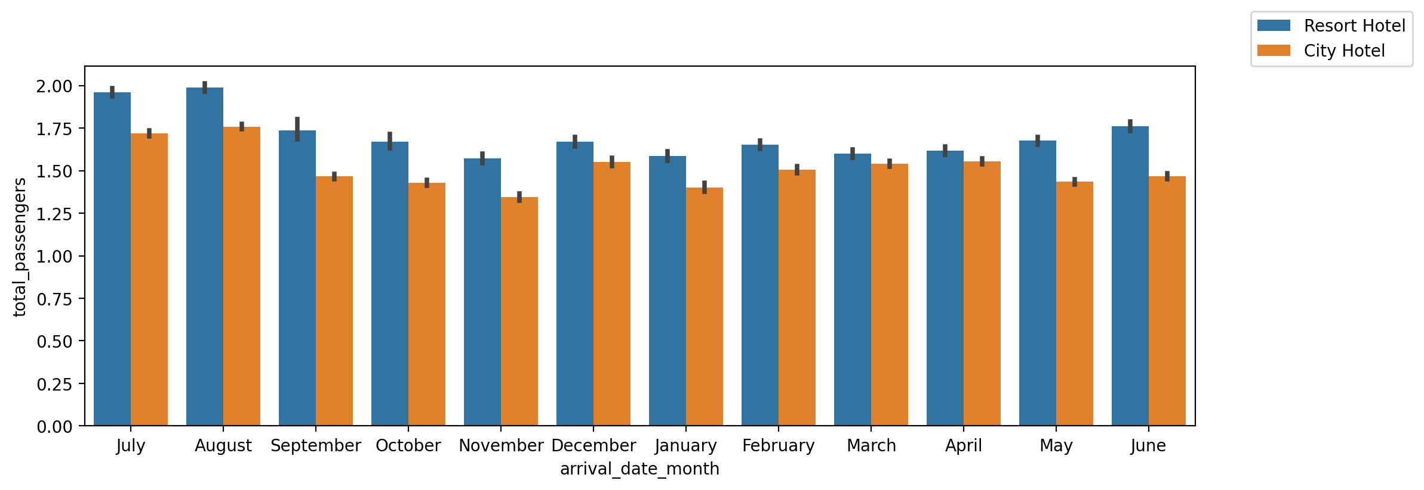
RESULT

Slide 12
Conclusion
In Conclusion, our proposed solution harnesses the power of advanced machine learning algorithms to transform the hotel reservation process into a dynamic and optimized experience. By meticulously analyzing extensive historical booking data, we unlock patterns and correlations that are pivotal in addressing key challenges faced by both travelers and hoteliers.

Slide 13
Future scope
The proposed solution lays the foundation for ongoing advancements in the realm of hotel reservation optimization. Here are key areas for future exploration and enhancement:
Real-time Predictions:
• Move towards real-time predictive models that account for instant changes in demand, external events, and other dynamic factors to provide users with up-to-the-minute insights for booking decisions.
Personalization and Customization:
• Enhance the predictive models to offer more personalized recommendations by considering individual guest preferences, loyalty history, and user-specific requirements, providing a tailored experience for each traveler.

Slide 14
References
https://www.kaggle.com/code/mohammadsabeti/hotel-booking-dataset-analysis/notebook
https://pandas.pvdata.org/pandas-docs/stable/user guide/index.html
https://seaborn.pydata.org/
https://matplotlib.org/stable/contents.html

Slide 15
THANK YOU

